Slide 1
UMLA: Unit-1
Distance Metrics
By
Dr. Anjali Dalvi (More)
Associate Professor
Department of Artificial Intelligence and Machine Learning Symbiosis Institute of Technology

Slide 2
Agenda
To discuss Manhattan, Minkowski, Chessboard and others

Slide 3
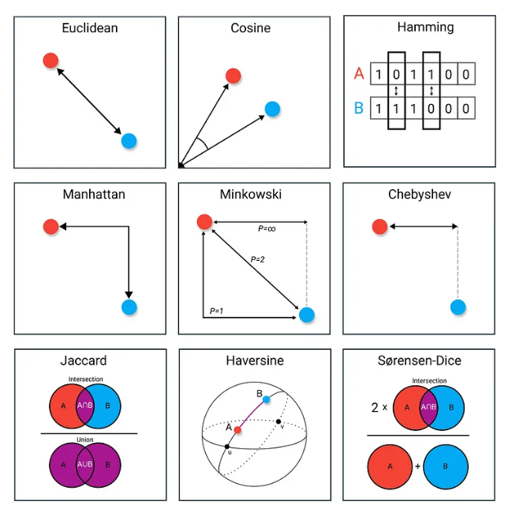
Distance Measures

Slide 4
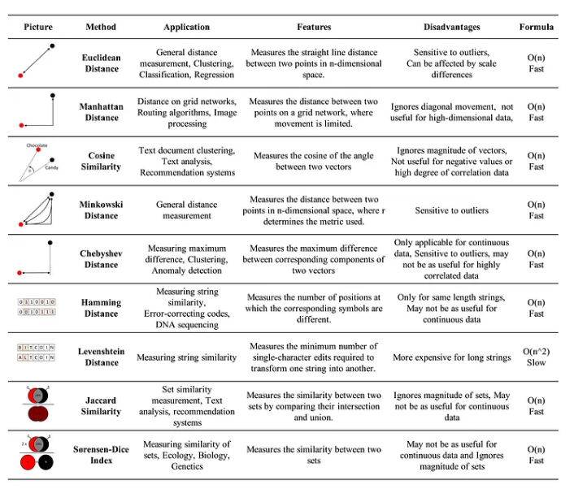
Distance Measures Details

Slide 5
Distance Metrics
Distance metrics are used in both supervised and unsupervised learning
Improves the performance of the machine learning model
Popular methods such as K-Means Clustering and k-nearest neighbor algorithm (KNN) use distance metric

Slide 6
Euclidean Distance
Euclidean Distance is a measure of the straight-line distance between two points in Euclidean space.
Euclidean distance between two points (x1, x2) and (y1, y2)
In higher-dimensional space (n), this formula extends to:
Some facts
Non-Negativity: Euclidean Distance is always non-negative.
Identity of Indiscernible:The distance between two identical points is 0.
Symmetry: The distance between point A and point B is the same as the distance between
point B and point A.

Slide 7
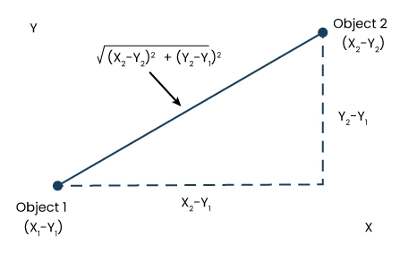
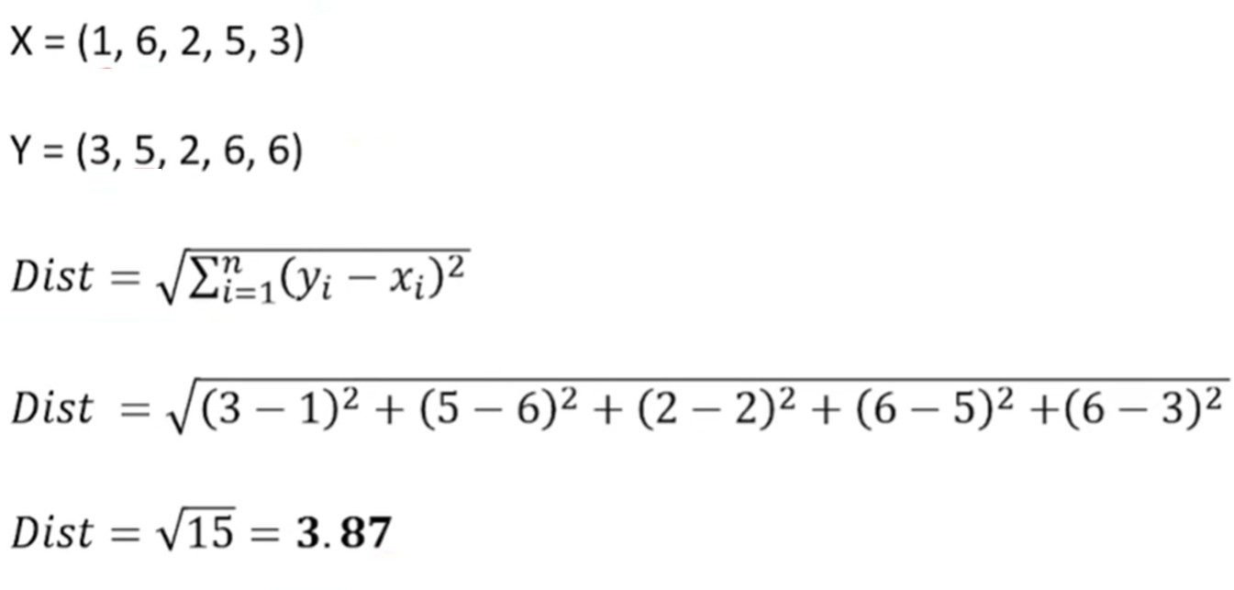
Euclidean Distance

Slide 8
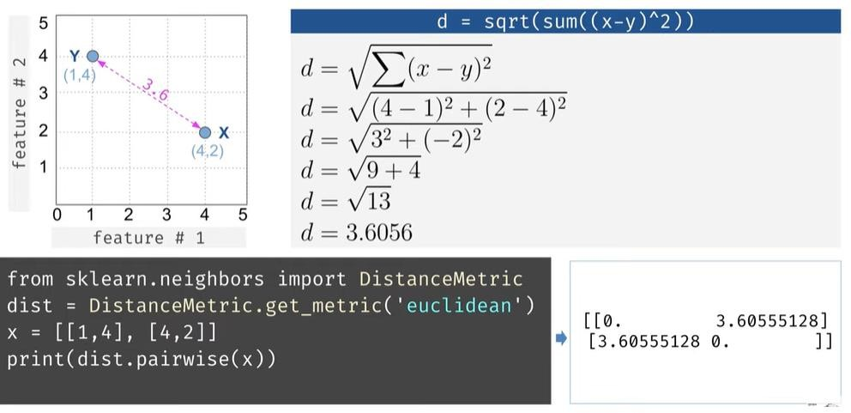
Euclidean Distance

Slide 9
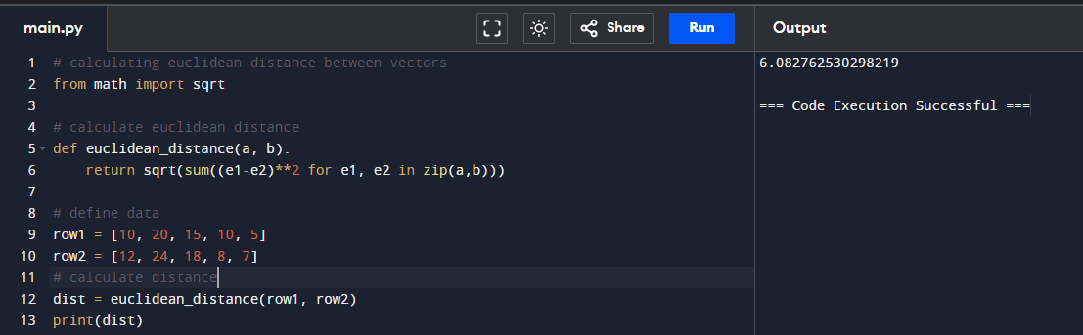
Euclidean Distance

Slide 10
Manhattan Distance
Manhattan Distance, also known as the L1 Norm or taxicab distance, is a distance metric used to measure the distance between two points in a grid-like path.
The Manhattan Distance between two points p1(x1, x2) and p2(y1, y2)
In higher-dimensional space (n), this formula extends to:
Similar to Euclidean Distance w.r.t. to Non-Negativity, Identity of Indiscernible, and Symmetry

Slide 11
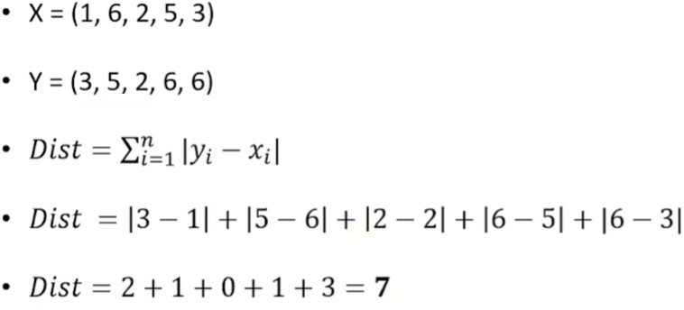
Manhattan Distance

Slide 12
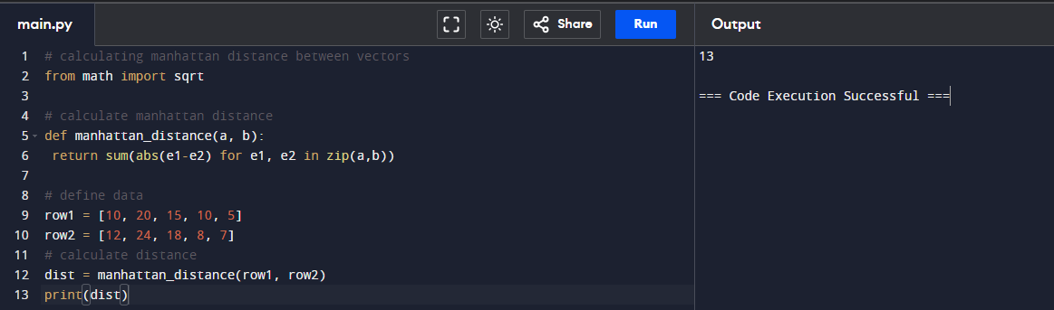
Manhattan Distance

Slide 13
Manhattan Distance
cityblock(u, v, w=None)[source]
Compute the City Block (Manhattan) distance. Computes the Manhattan distance between two 1-D arrays u and v, which is defined as. ∑ i | u i − v i | .
# calculating manhattan distance between vectors
from scipy.spatial.distance import cityblock
# define data
row1 = [10, 20, 15, 10, 5]
row2 = [12, 24, 18, 8, 7]
# calculate distance
dist = cityblock(row1, row2)
print(dist)

Slide 14
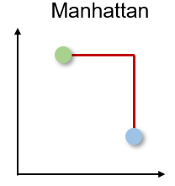
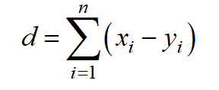
Manhattan distance
The Manhattan distance is also called the Taxicab or City-Block distance as the distance between two
real-valued vectors is calculated as if one could only move at right angles.
This distance measure is often used for discrete and binary attributes to get a realistic path.
The Manhattan distance is based on a L1-norm and is calculated by:
and can be implemented in Python by:
from scipy.spatial import distance distance.cityblock(vector_1, vector_2)
The Manhattan distance has two major disadvantages.
First, it is less intuitive than the Euclidean distance in high dimensional space and second, it does not show the shortest path possible.
Manhattan Distance

Slide 15
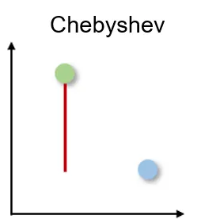
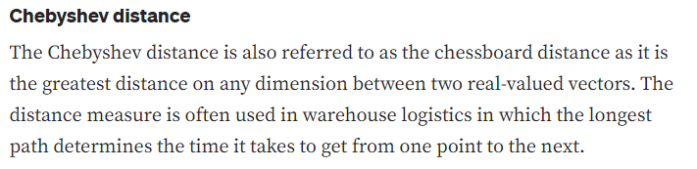

Chebyshev distance
The Chebyshev distance is calculated by the L-infinity-norm:
We can calculate the distance in Python by:
from scipy.spatial import distance distance.chebyshev(vector_1, vector_2)
The Chebyshev distance has only very specific use case and is thus very seldom used.

Slide 16
Chebyshev distance
The Chebyshev distance, also known as the L ∞ norm, calculates the maximum
absolute difference between the corresponding coordinates of two points.
P and Q in a two-dimensional space with coordinates (x1, y1) and (x2, y2)
In higher-dimensional space (n), this formula extends to:

Slide 17
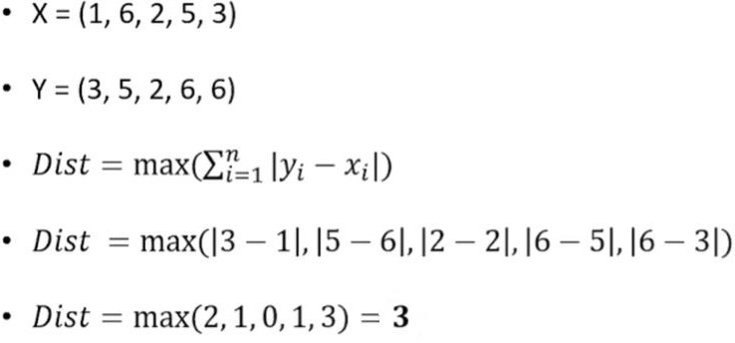
Chebyshev distance

Slide 18
Minkowski Distance
Chebyshev Distance, also known as the L∞ Norm or maximum norm, is a distance metric used to measure the distance between two points in terms of their maximum difference along any dimension.
The Chebyshev Distance between two points A(x1, x2) and B(y1, y2)
In higher-dimensional space (n), this formula extends to:
It is through the parameter p that we can vary the distance norm we are calculating. The Minkowski distance with p = 1 gives us the Manhattan distance, and with p = 2 we get the Euclidean distance. Also, p = ∞ gives us the Chebychev Distance.

Slide 19
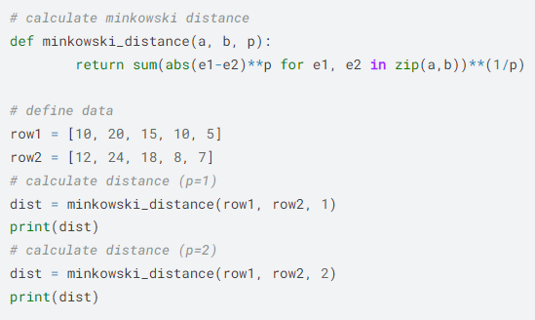
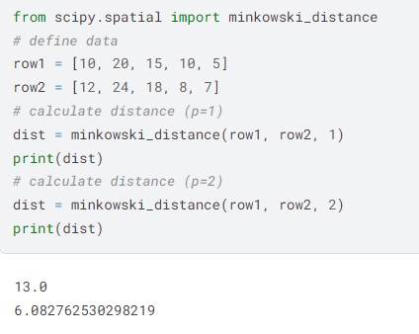


Slide 20
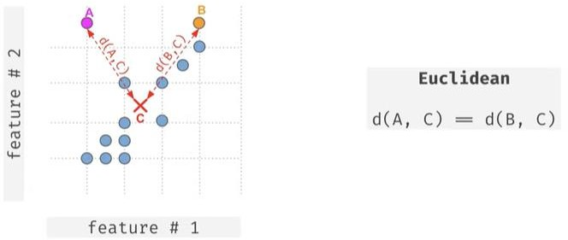
Mahalanobis Distance

Slide 21
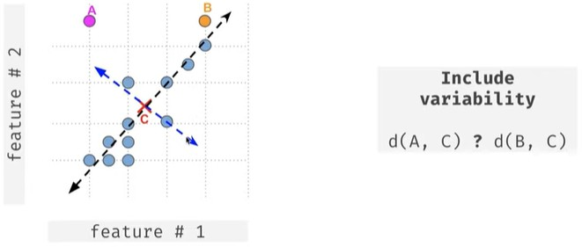
Mahalanobis Distance

Slide 22
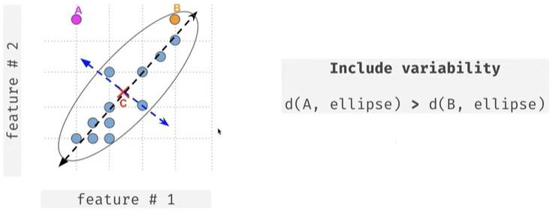
Mahalanobis Distance

Slide 23
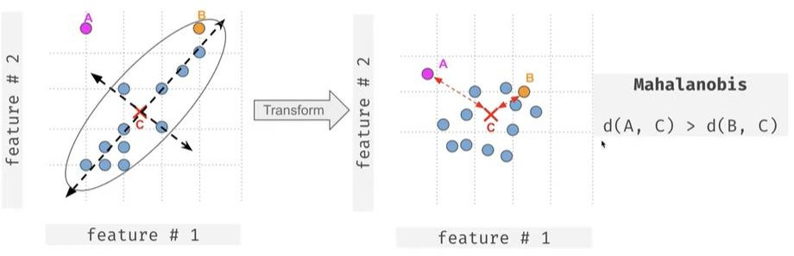
Mahalanobis Distance

Slide 24
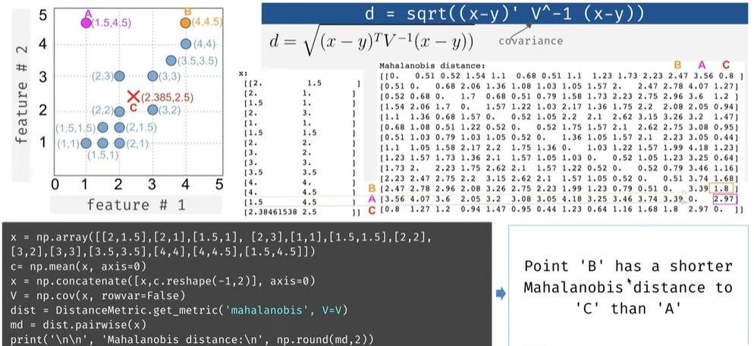
Mahalanobis Distance

Slide 25
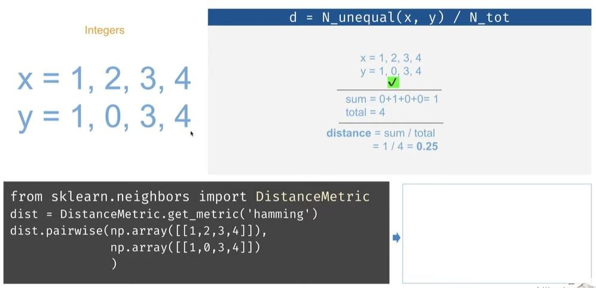
Hamming Distance

Slide 26
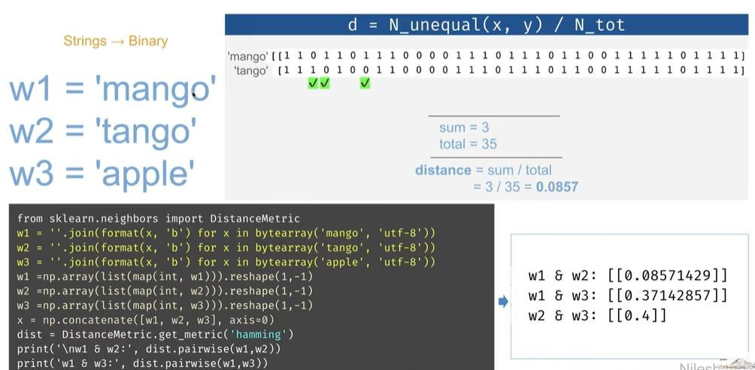
Hamming Distance

Slide 27
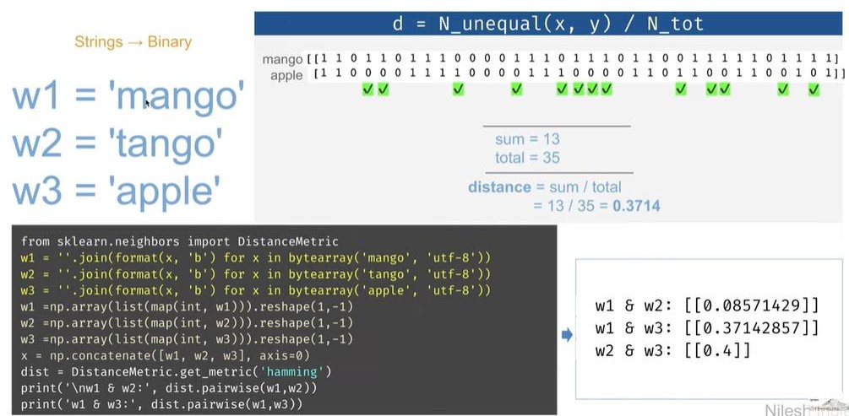
Hamming Distance

Slide 28
Canbera Distance
Canberra distance is a distance measure used to calculate the distance between two points based on the differences between their corresponding components.
It is useful when comparing data that is not necessarily normalized or standardized, such as in image recognition or text classification.
Canberra distance calculates the sum of the absolute differences between the components of the two points, divided by the sum of their absolute values.
It is a weighted distance measure that emphasizes larger differences between the components and is more robust to outliers than other distance measures.
However, it can be sensitive to the order in which the components are presented, which can affect its performance in some applications.

Slide 29
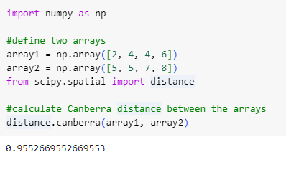
import numpy as np #define two arrays array1 = np.array([2, 4, 4, 6]) array2 = np.array([5, 5, 7, 8]) from scipy.spatial import distance #calculate Canberra distance between the arrays distance.canberra(array1, array2)
0.9552669552669553

Slide 30
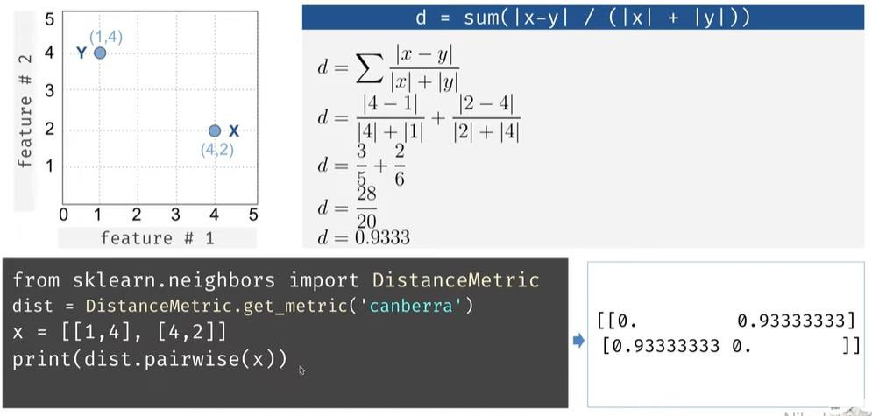
Canbera Distance

Slide 31
Braycurtis Distance
Similar to Canbera distance metric
The Bray-Curtis distance is a statistic that measures the dissimilarity . It's a popular measure in community ecology and is named after J. Roger Bray and John T. Curtis, who first presented it in a paper in 1957
The Bray-Curtis distance is in the range [0, 1] if all coordinates are positive, and is undefined if the inputs are of length zero. Parameters: u(N,) array_like. Input array.

Slide 32
Braycurtis Distance
Similar to Canbera distance metric
from scipy.spatial import distance
distance.braycurtis([1, 0, 0], [0, 1, 0])
distance.braycurtis([1, 1, 0], [0, 1, 0])
0.3333333333333333

Slide 33
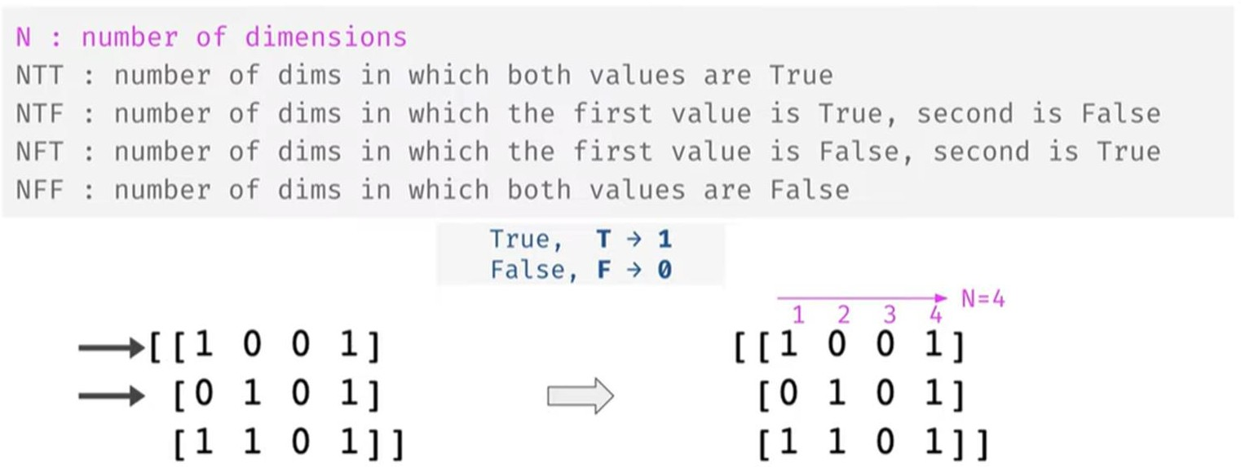
Boolean Valued Vectors

Slide 34
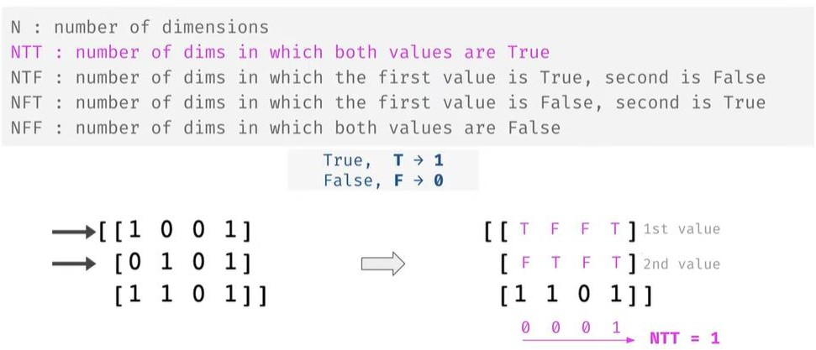
Boolean Valued Vectors

Slide 35
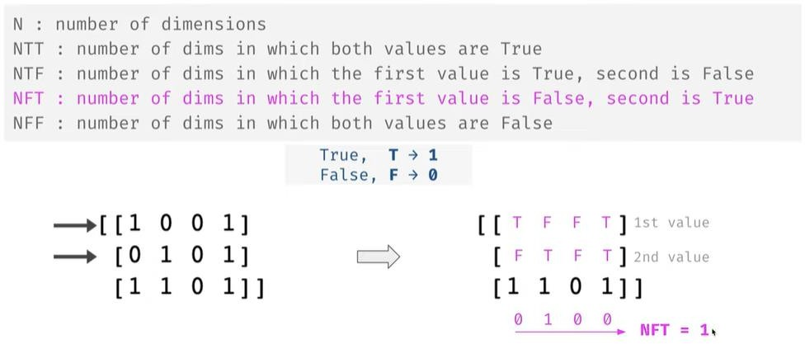

Boolean Valued Vectors

Slide 36
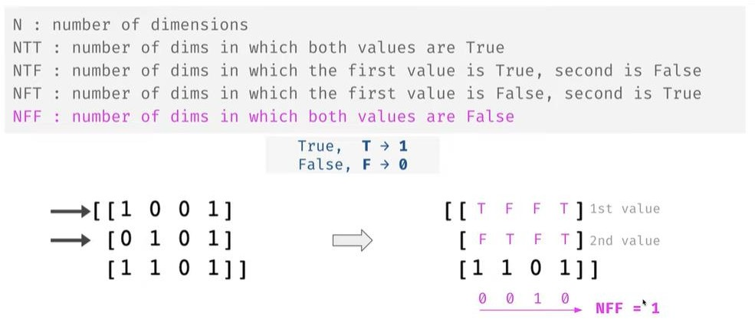

Boolean Valued Vectors

Slide 37
Jaccard Distance
Jaccard distance is commonly used to calculate an n × n matrix for clustering and multidimensional scaling of n sample sets.
This distance is a metric on the collection of all finite sets. , since these formulas are not well defined in these cases.
Jaccard Similarity is a common proximity measurement used to compute the similarity between two objects, such as two text documents. Jaccard similarity can be used to find the similarity between two asymmetric binary vectors or to find the similarity between two sets. In literature, Jaccard similarity, symbolized by J, can also be referred to as Jaccard Index, Jaccard Coefficient, Jaccard Dissimilarity, and Jaccard Distance.

Slide 38
Jaccard Similarity is frequently used in data science applications. Example use cases for Jaccard Similarity:
Text mining: find the similarity between two text documents using the number of terms used in both documents
E-Commerce: from a market database of thousands of customers and millions of items, find similar customers via their purchase history
Recommendation System: Movie recommendation algorithms employ the Jaccard Coefficient to find similar customers if they rented or rated highly many of the same movies.

Slide 39
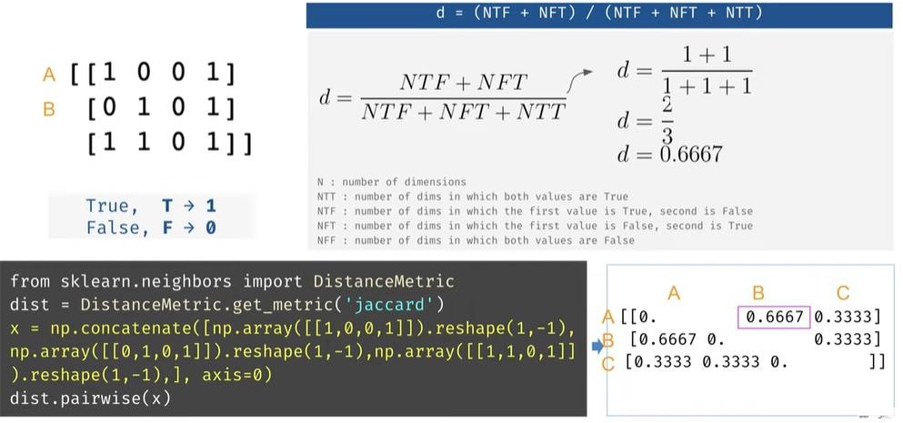
Jaccard Distance

Slide 40
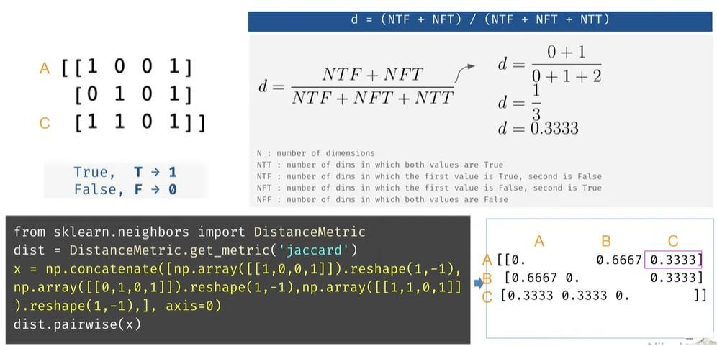
Jaccard Distance

